Slide 1



School Waste Audit
EHG_00036_V2. Created by Rachel Kernaghan & Dr Michelle Blewitt, Nov 2016

Slide 2

What is waste?

Slide 3
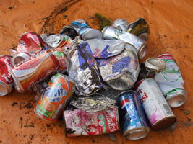
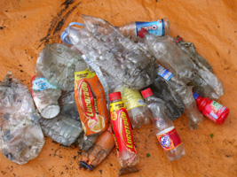
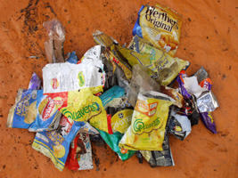
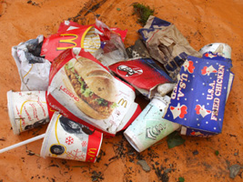
Is this waste?

Slide 4
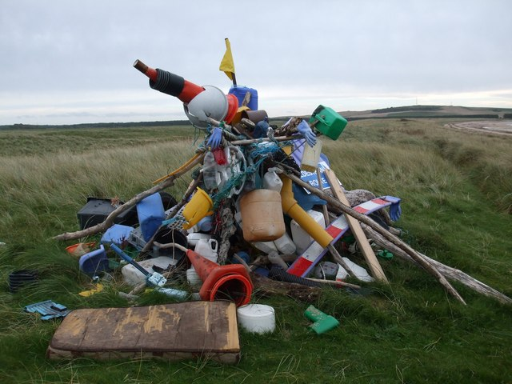
Who decides what is waste?

Slide 5

It could be any of these…
Individuals – you???
Schools – Primary, High
Groups – surf clubs, guides
Businesses – cafes, offices
Government – local council

Slide 6
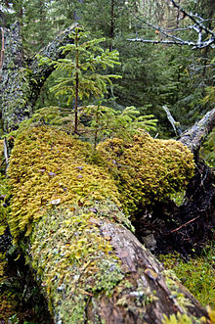
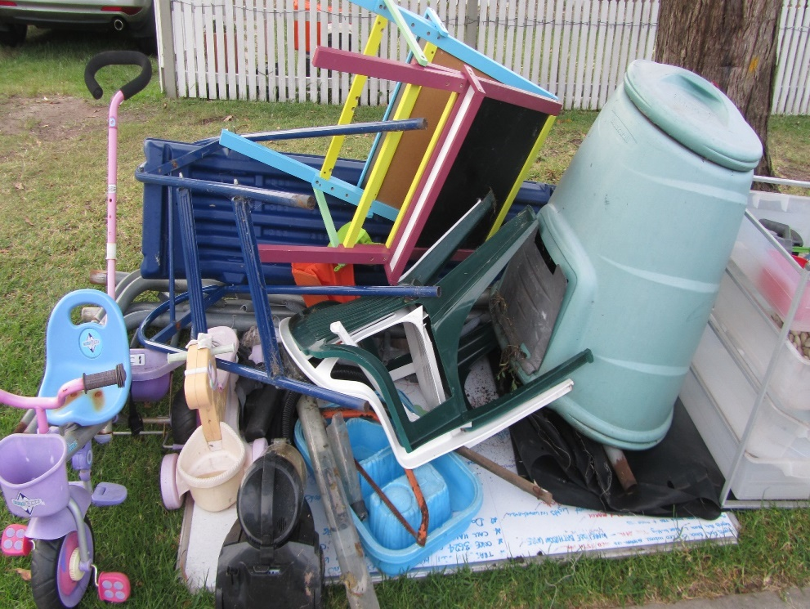
There’s no such thing as waste!
Waste is a decision (a verb)
Nature doesn’t have waste

Slide 7
What could we do with the object this student is holding?
What could it become?

Slide 8
The 4 R’s
Rethink
Reduce
Reuse
Recycle

Slide 9
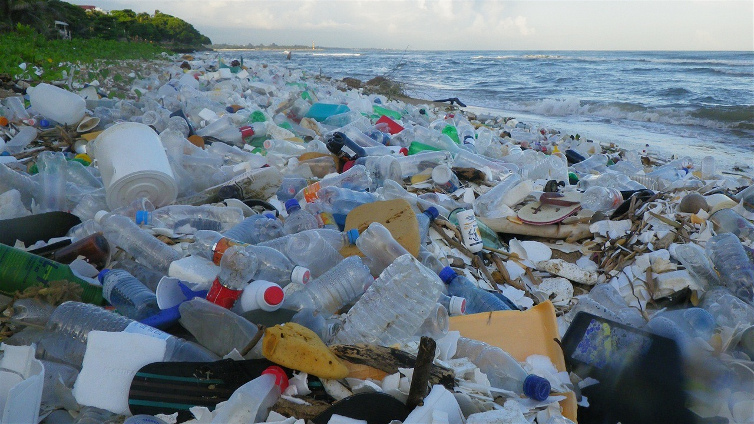

Slide 10
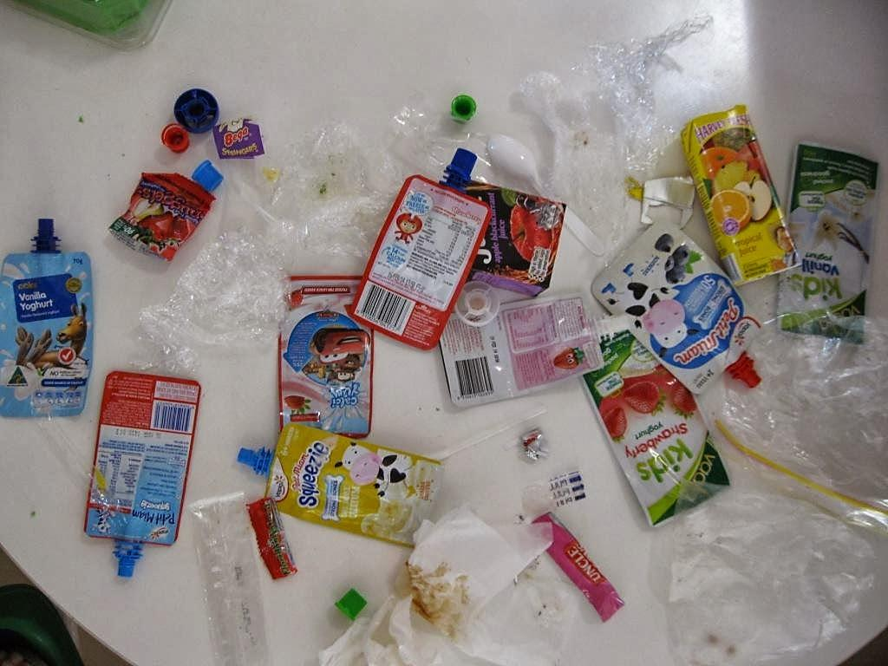
What problems do some of these items cause here at school?

Slide 11
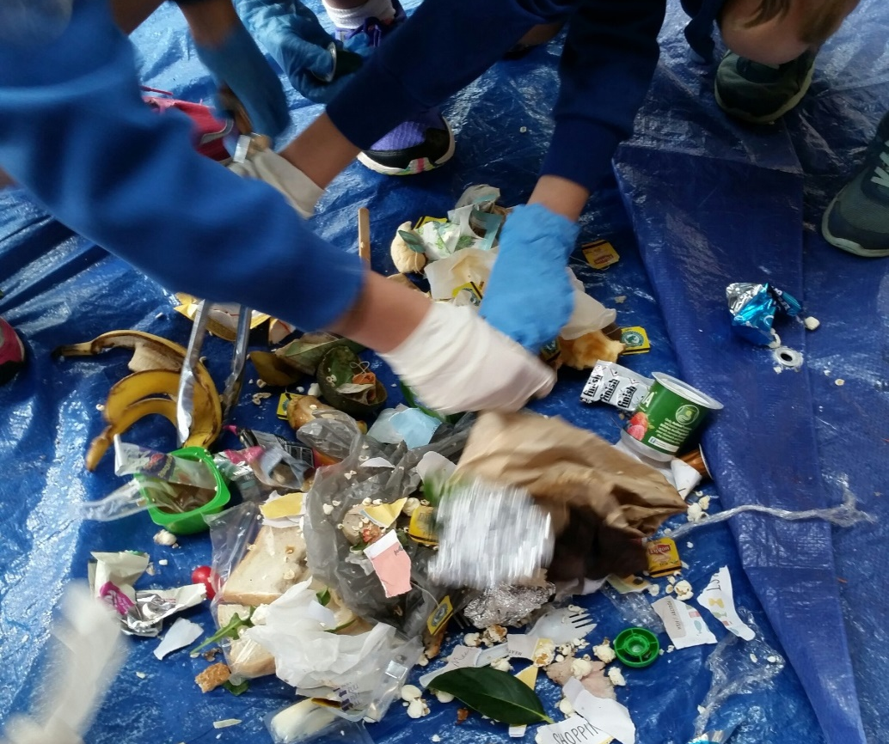
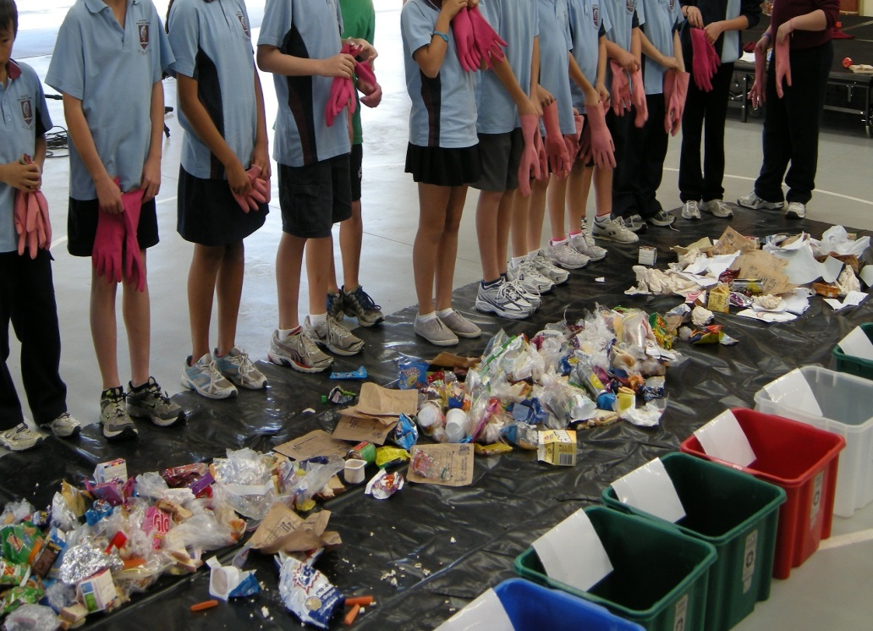
School Bin Waste Audit

Slide 12
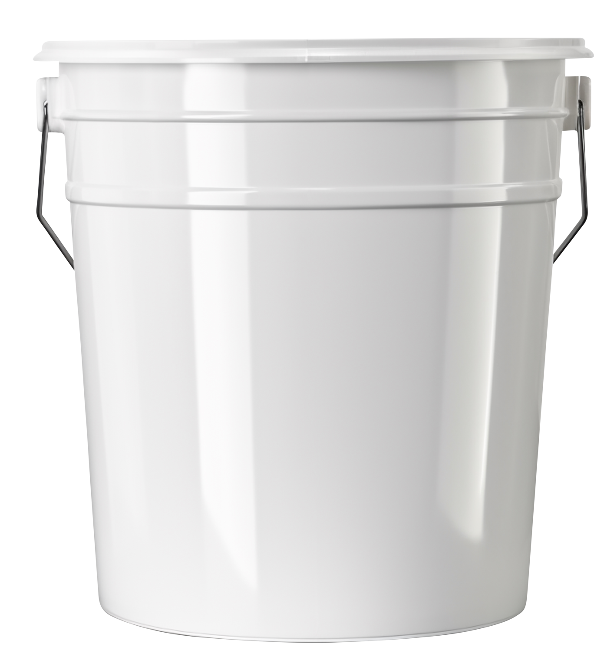
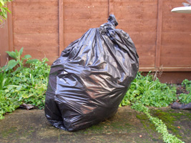
Part 1 - School Bin Waste Audit
Mixed Containers
AVOID
(Landfill)
Food
Scraps
Garden Vegetation
Paper & Cardboard

Slide 13
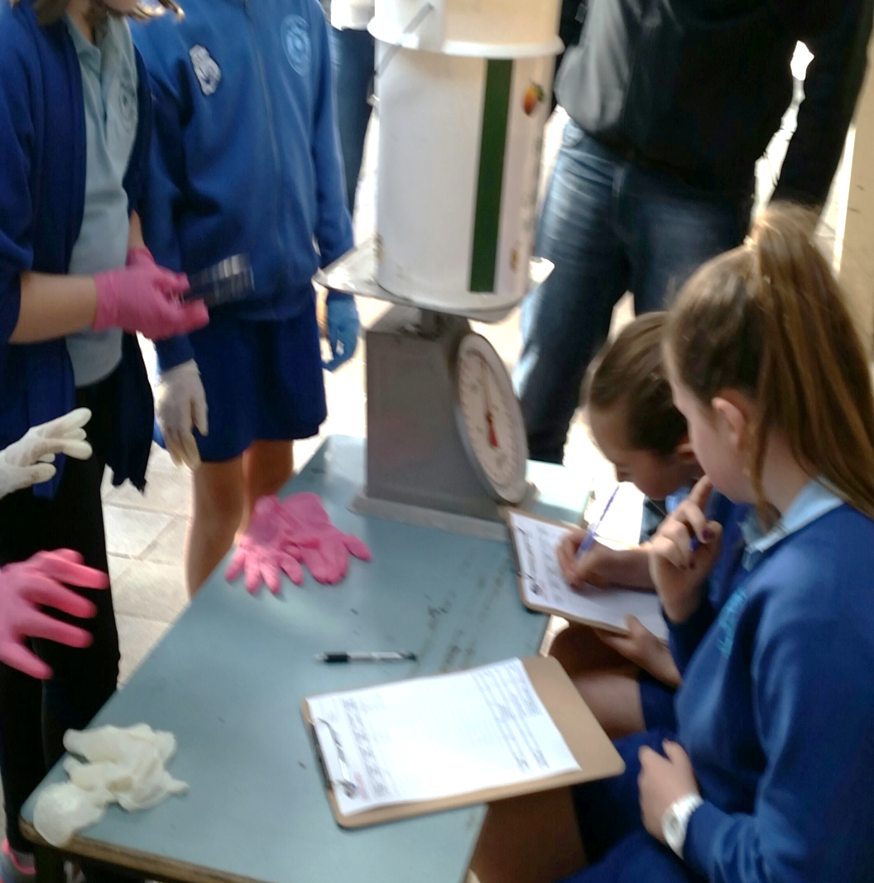
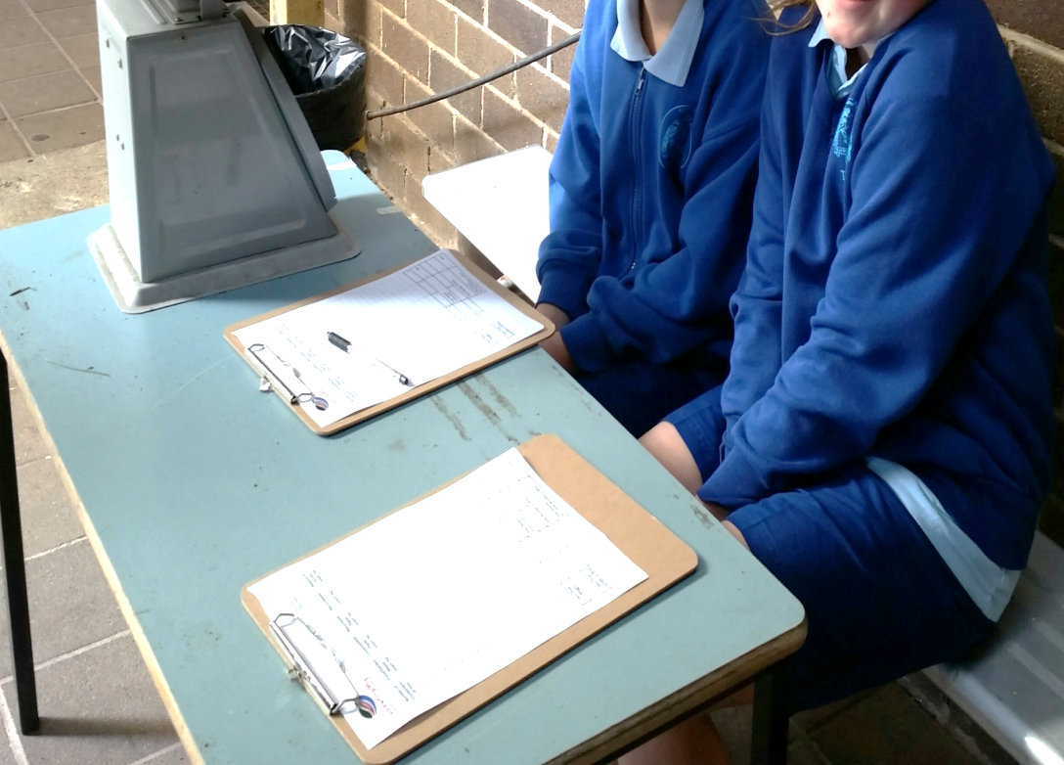
Weigh Station & Recording Data

Slide 14
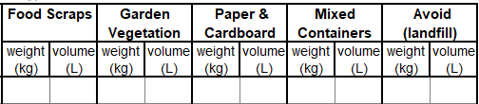
2 Measurements:
Weight (kg) and Volume (L)
Weight = how much the contents of each bucket weighs. Measured in kilograms (kg)
Volume = How much space the contents of each bucket takes up. Measured in Litres (L)

Slide 15
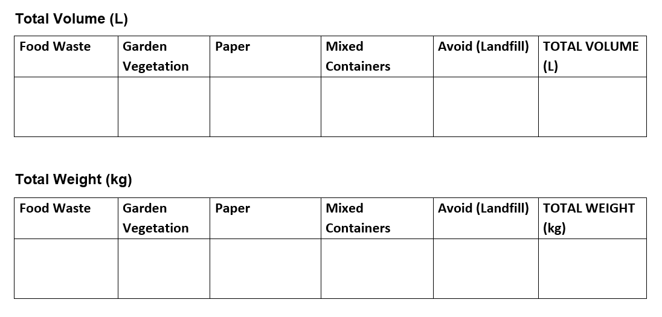
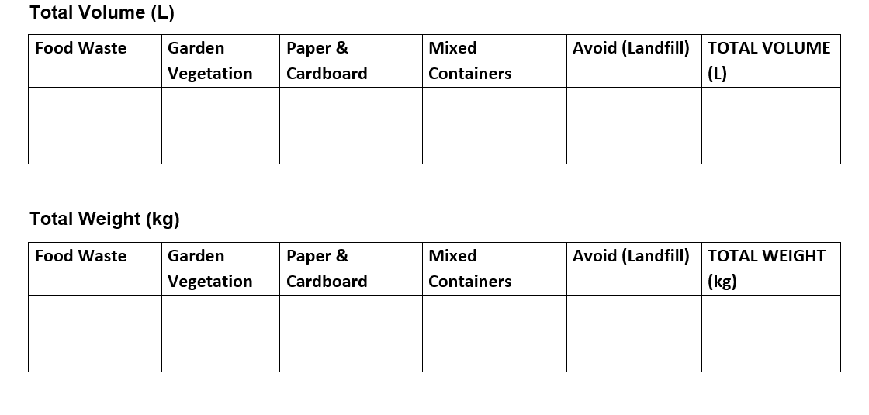
School Bin Waste Audit Collation of Results

Slide 16
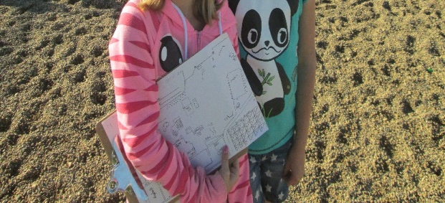
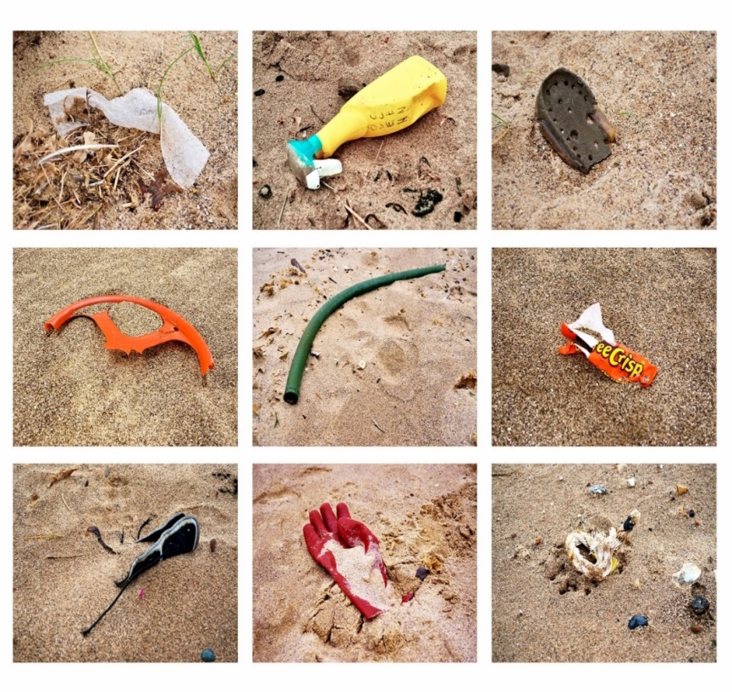
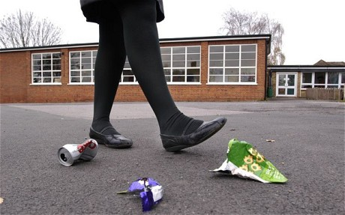
Part 2 -
Playground Litter Audit

Slide 17
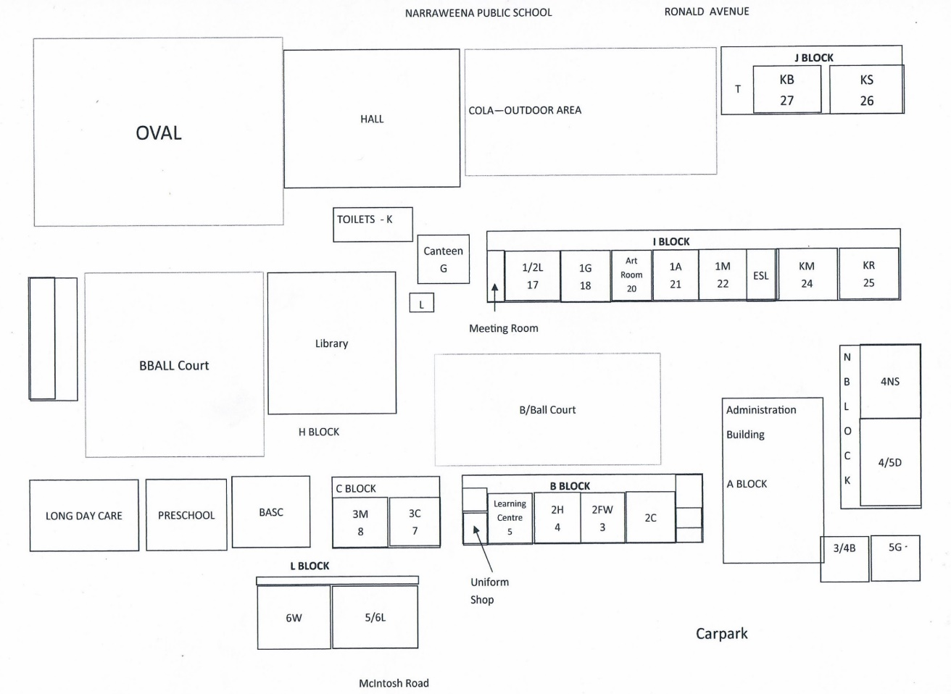
GROUP NO: ______________
Insert a Map of your school here and use the key to annotate the location of bins and litter at your school
BINS
X LITTER
NAMES: _______________________

Slide 18

What are 3 important things you could do to improve this situation here at school?

Slide 19
GOOD LUCK with the change you want to see in your school!
YOU’VE GOT THIS!

Slide 20
Want to do more in your Community?
Sort your waste at the source at home and encourage everyone in your household & neighbours to do the same
Join a Citizen Science Project like AUSMAP to track and map microplastics in our waterways and oceans
Join a local Clean Up Crew in your area
Take 3 for the Sea every time you visit the beach

